Slide 1

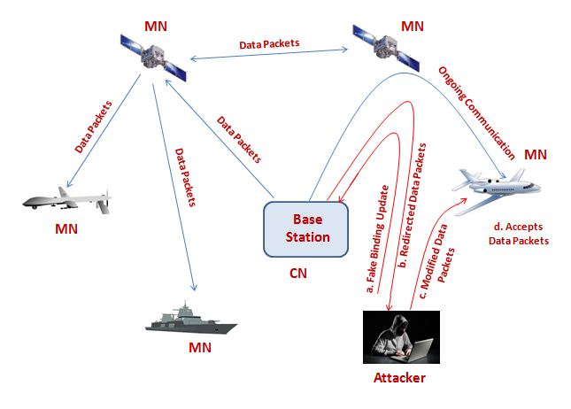
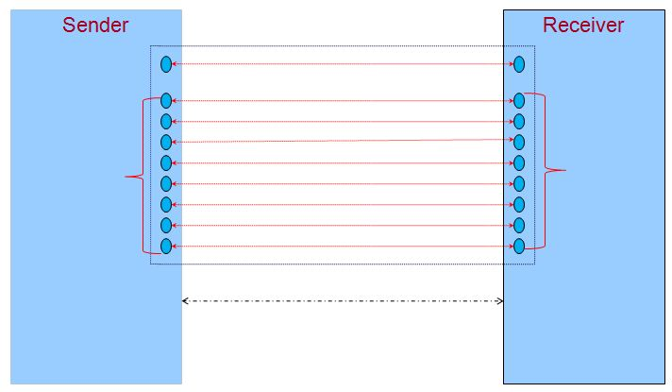
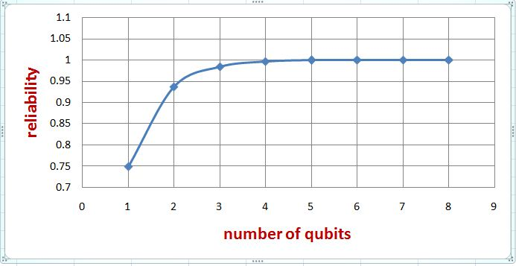
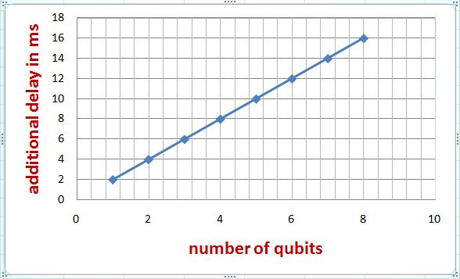


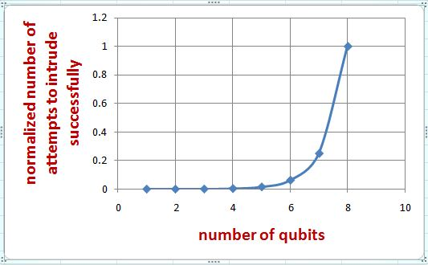
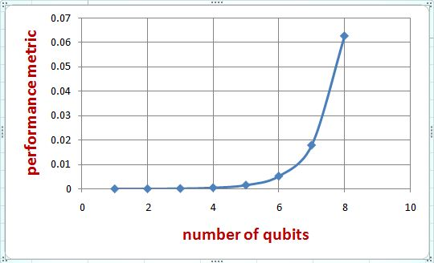


Runtime Authentication in Highly-Secured Network Systems
Iftakhar Ahmad
Email: 0905058.ia@ugrad.cse.buet.ac.bd
Background
Motivation behind Our Work
Authentication is the process of verifying that a user is permitted to access or communicate to a system. The end result of the authentication process is that the user is either accepted as a legitimate user or rejected as an invalid user, while attempting to access the system.
Active Intruder in a network is one, who intrudes an ongoing communication, modifies data packets, and sends them to the receiver.
Quantum entanglement is a phenomenon in which two or more particles are generated or interact in a way so that if there is a change in one particle, there will be instantaneous change(s) in other particle(s).
Qubit or quantum bit is the fundamental unit of quantum computation and analogous to classical bits.
Superdense Coding is a method of increasing rate of data transfer in quantum communication [1].
Steps of Operation in Our Approach
Figure: Active intruder sends modified data packets to a mobile node by spoofing binding update
1. Sender and receiver share one pair of qubit to exchange an intent to begin data transfer and eight pairs of qubits to exchange the authentication code. Sender makes change in one qubit to initiate data packet transfer.
2. Receiver observes the change from the intent-qubit.
3. Receiver generates a 16-bit code. The code is applied in receiver’s 8 code-qubits using superdense coding [1] and sent to the sender.
4. Sender measures its 8-qubit code [2].
5. Sender encapsulates received code with data packet, and sends to receiver through a classical channel.
6. Receiver compares the code of data packet with the sent code. It accepts the data packet both codes matchs. Otherwise, it rejects the data packet.
The receiver also discards the data packet, if it arrives after a specific delay, to prevent reflection attack.
System Model
1. Give Intent
9 entangled qubit pairs
2. Receive Intent
4. Receive Code
3. Send Code
5. Combine code with data packet and send
Classical channel for transmission of data packets
6. Verify code and accept
if correct,
otherwise, reject
Operational Issue: Re-Establishing Entanglement
After measuring the qubits, entanglement will be destroyed.
  However, as we are measuring the entanglement optically [2], we will be able to re-establish the entanglement optically.
The protocol that will be used can prepare entanglement between two remote particles [5].
  The nine qubit pairs will be entangled again immediately after measurement at the sender’s side and will be ready for exchanging authentication key of the next packet.
Simulation on Design Parameters
Design Issues
Each qubit represents two classical bits. If we use 8 qubits, there will be 2¹⁶ possible codes. Therefore, for q number of qubits in a code
  Probability for an active intruder to correctly guess the code is
  Reliability that receiver operates without accepting any malicious/ modified data packets is
Total number of bits in data packet is 2q+p. Therefore,
  - Bit rate of communication is , where, p is size of classical data packet in bits.
The time needed for a gate operation of 2-qubit system is approximately 4 ms [3]. Therefore,
  - Propagation delay is increased by approximately ms, which is about 14.47% [4] of propagation delay of low earth orbit satellites.
Figure: Change in reliability in response to an increase in the number of qubits
Figure: Impact on additional delay in response to an increase in the number of qubits
Figure: Change in normalized number of attempts needed to intrude successfully. in response to an increase in the number of qubits
Figure: Impact on performance metric in response to an increase in the number of qubits
Conclusion and Future Work
We propose a system to incorporate runtime authentication in highly-secured network systems.
We exploit a quantum features of particles called entanglement to exchange runtime authentication code.
In future, we plan to do the following:
  Simulate the whole system.
  Analyze synchronization between exchanging the codes in qubits and exchanging the data packets.
  Explore a real application of the proposed authentication system in online money transaction system.
References
[1] C. H. Bennett and S. J. Wiesner, “Communication via one-and two-particle operators on einstein-podolsky-rosen states,” Physical review letters, vol. 69, no. 20, p. 2881, 1992.
[2] C. G. Yale, B. B. Buckley, D. J. Christle,L. C. Bassett, and D. D. Awschalom, “All-optical control of a solid-state spin using coherent dark states,” National Academy of Sciences, vol. 110, no. 19, pp. 7595–7600, 2013.
[3] Ashhab, S., P. C. De Groot, and Franco Nori. "Speed limits for quantum gates in multiqubit systems." Physical Review A 85.5 052327, 2012.
[4] Goyal, Rohit, et al. “Analysis and Simulation of Delay and Buffer Requirements of Satellite-ATM Networks for TCP/IP Traffic.” arXiv preprint cs/9809052, 1998.
[5] Abdi, Mehdi, Paolo Tombesi, and David Vitali. "Entangling two distant non‐interacting microwave modes." Annalen der Physik 527.1-2 139-146, 2015.
Department of Computer Science and Engineering (CSE), BUET

